Slide 1
Validation

Slide 2



Slide 3

Module Overview
Setting Built-in Validation Rules
Adjusting Validation Rules at Runtime Custom Validators
Custom Validators with Parameters Cross-field Validation

Slide 4
Creating the Root FormGroup
ngOnInit(): void {
this.customerForm = this.fb.group({ firstName: '',
lastName: '',
email: '', sendCatalog: true
});
}

Slide 5
Creating the FormControls
this.customerForm = this.fb.group({ firstName: '',
sendCatalog: true
});
this.customerForm = this.fb.group({
firstName: {value: 'n/a', disabled: true}, sendCatalog: {value: true, disabled: false}
});
this.customerForm = this.fb.group({ firstName: [''], sendCatalog: [true]
});

Slide 6
Setting Built-in Validation Rules
this.customerForm = this.fb.group({ firstName: ['', Validators.required], sendCatalog: true
});
this.customerForm = this.fb.group({ firstName: ['',
[Validators.required, Validators.minLength(3)]], sendCatalog: true
});

Slide 7
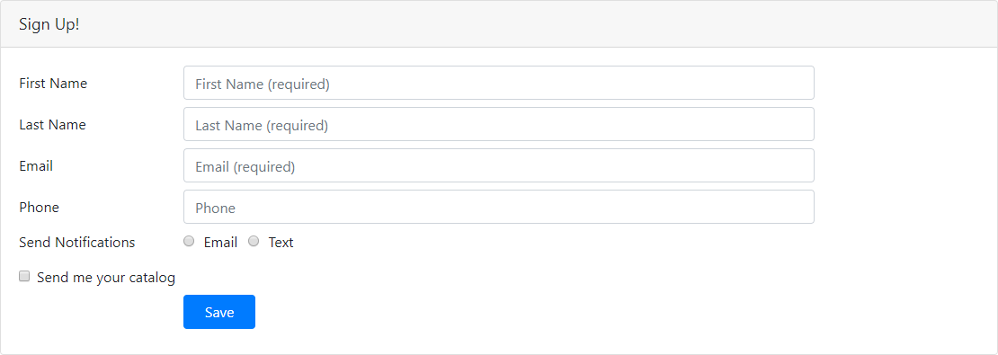
Adjusting Validation Rules at Runtime

Slide 8
Adjusting Validation Rules at Runtime
myControl.setValidators(Validators.required);
myControl.setValidators([Validators.required,
Validators.maxLength(30)]);
myControl.clearValidators();
myControl.updateValueAndValidity();

Slide 9
Custom Validator
function myValidator(c: AbstractControl): {[key: string]: boolean} | null {
if (somethingIsWrong) {
return { 'myvalidator': true };
}
return null;
}

Slide 10
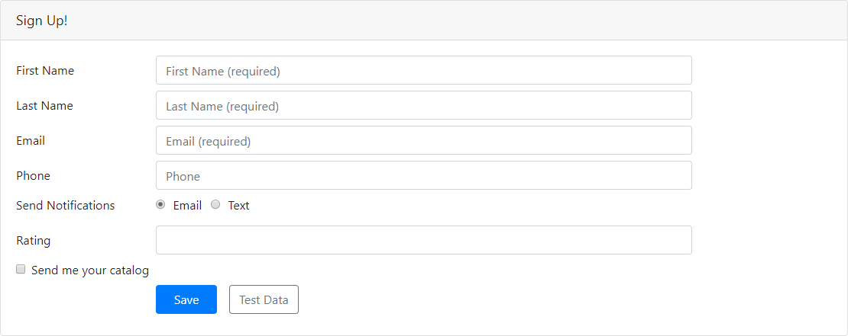
Custom Validator

Slide 11
Custom Validator
function myValidator(c: AbstractControl): {[key: string]: boolean} | null {
if (somethingIsWrong) {
return { 'myvalidator': true };
}
return null;
}

Slide 12
Custom Validator with Parameters
function myValidator(param: any): ValidatorFn {
return (c: AbstractControl): {[key: string]: boolean} | null => { if (somethingIsWrong) {
return { 'myvalidator': true };
}
return null;
};
}

Slide 13
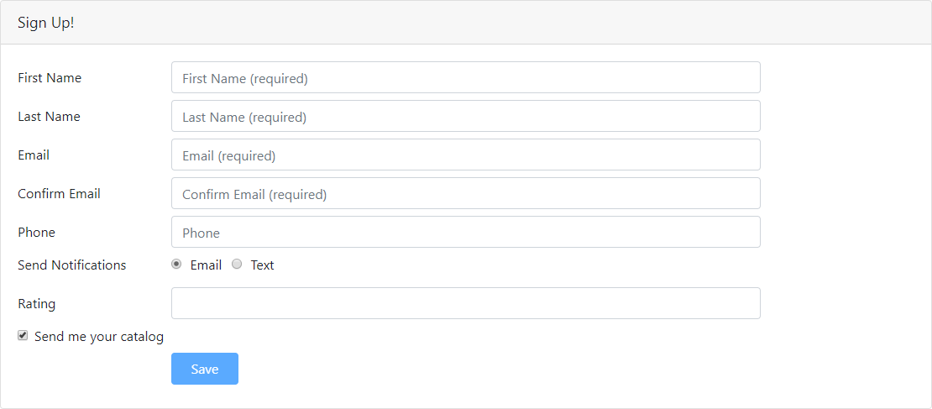
Cross-field Validation

Slide 14
Cross-field Validation: Nested FormGroup
this.customerForm = this.fb.group({
firstName: ['', [Validators.required, Validators.minLength(3)]], lastName: ['', [Validators.required, Validators.maxLength(50)]], availability: this.fb.group({
start: ['', Validators.required], end: ['', Validators.required]
})
});
<div formGroupName="availability">
...
<input formControlName="start"/>
...
<input formControlName="end"/>
</div>

Slide 15
Cross-field Validation

Slide 16
Cross-field Validation: Custom Validator
function dateCompare(c: AbstractControl): {[key: string]: boolean} | null { let startControl = c.get('start');
let endControl = c.get('end');
if (startControl.value !== endControl.value) { return { 'match': true };
}
return null;
}
this.customerForm = this.fb.group({
firstName: ['', [Validators.required, Validators.minLength(3)]], lastName: ['', [Validators.required, Validators.maxLength(50)]], availability: this.fb.group({
start: ['', Validators.required], end: ['', Validators.required]
}, { validator: dateCompare })
});

Slide 17

Checklist: Setting Built-in Validation Rules
Import Validators
Pass in the validator or array of validators
ngOnInit(): void { this.customerForm = this.fb.group({
firstName: ['', Validators.required], lastName: ['', [Validators.required,
Validators.maxLength(30)]],
email: '', sendCatalog: true
});
}

Slide 18
Checklist: Adjusting Validation Rules
Determine when to make the change
Use setValidators or clearValidators Call updateValueAndValidity
setNotification(notifyVia: string): void { const p = this.myForm.get('phone');
if (notifyVia === 'text') { p.setValidators(Validators.required);
} else { p.clearValidators();
}
p.updateValueAndValidity();
}

Slide 19
Checklist: Custom Validators
Build a validator function
function myValidator(c: AbstractControl):
{[key: string]: boolean} | null { if (somethingIsWrong) {
return { 'thisValidator': true };
}
return null;
}
Use it like any other validator
this.customerForm = this.fb.group({ firstName: ['', myValidator], sendCatalog: true
});

Slide 20
Checklist: Custom Validators with Parameters
Wrap the validator function in a factory function
function myValidator(param: any): ValidatorFn { return (c: AbstractControl):
{[key: string]: boolean} | null => { if (c.value === param) {
return { 'thisvalidator': true };
}
return null;
}}
Use it like any other validator
this.customerForm = this.fb.group({ firstName: ['', myValidator('test')]
});

Slide 21
Checklist: Cross-field Validation: FormGroup
Create a nested FormGroup
Add FormControls to that FormGroup
this.customerForm = this.fb.group({ name: ['', Validators.required], availability: this.fb.group({
start: ['', Validators.required], end: ['', Validators.required]
})
});
Update the HTML
<div formGroupName="availability">
<input formControlName="start"/>
<input formControlName="end"/>
</div>

Slide 22
Checklist: Cross-field Validation: Validator
Build a custom validator
function dateCompare(c: AbstractControl) { if (c.get('start').value !==
c.get('end').value) { return { 'match': true };
}
return null;
}
Use the validator
this.customerForm = this.fb.group({ name: ['', Validators.required], availability: this.fb.group({
start: [null, Validators.required], end: [null, Validators.required]
}, { validator: dateCompare })
});

Slide 23
Setting Built-in Validation Rules
Adjusting Validation Rules at Runtime Custom Validators
Custom Validators with Parameters Cross-field Validation
Summary

